Slide 1
Grip Torque Data
January 23, 2020

Slide 2
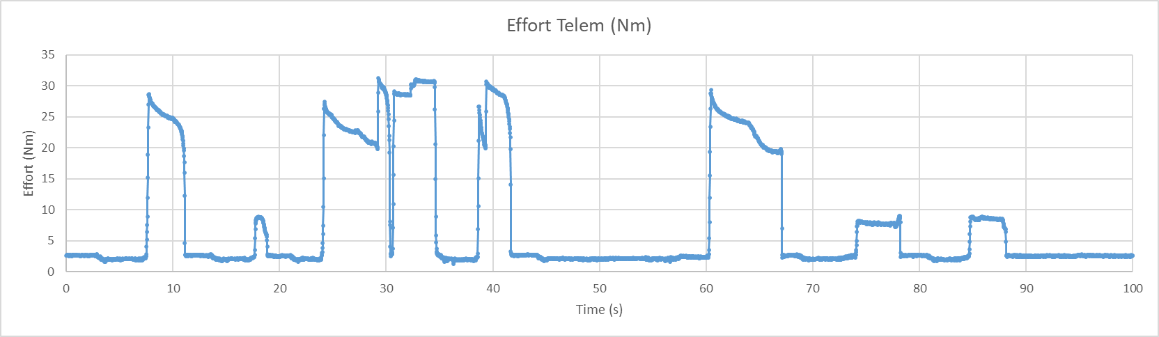
Torque Events
1
2
3
4
5
7
6
1 – Aluminum Object, tight grip, object removed
2 - Aluminum Object, light grip, object removed
3 - Aluminum object, tight grip, continuous command to close, object removed
4 – Aluminum object, tight grip, object removed
5 – Flexible object, tight grip, object removed
6 - Flexible object, light grip, object removed
7 - Flexible object, light grip, object removed

Slide 3
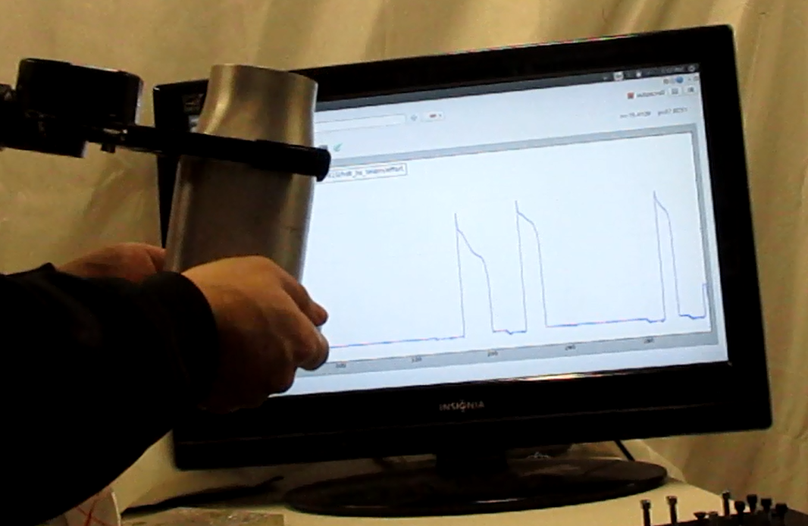
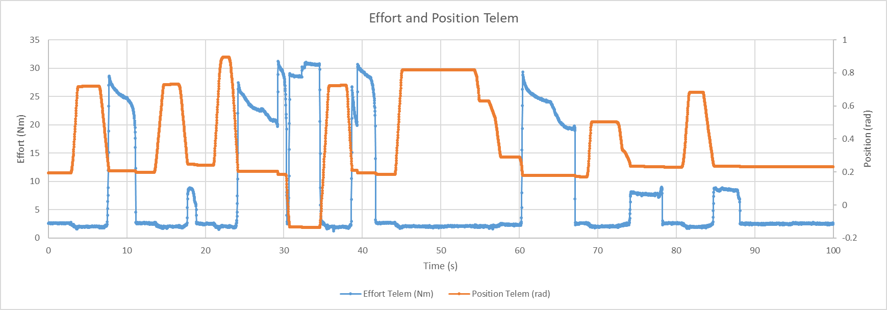
Effort and Position

